Slide 1

Retail Sales Alaysis Dashboard Using PowerBI
Presented By Abhay Dahe ( pba25_04001)

Slide 2
Most & Least Profitable Categories & Regions
Technology Dominates
Furniture Underperforms
50.79% of total profit, making it our strongest category.
Only 6.44% of profit, signaling a need for reassessment.
West Region Leads
Central Region Lags
Contributes 37.86% of total profit, highest among all regions.
Lowest profit at 13.86%, requiring strategic focus.
Action: Prioritize investments in Technology and the West, while re-evaluating strategies for Furniture and the Central Region to boost overall profitability.

Slide 3

Top City Driving Revenue
New York Leads with $1.26 Million
Highest revenue contribution, showcasing strong market demand.
Consistent performance driven by large customer base.
Key market for focused investment and targeted campaigns.
Opportunity to replicate successful strategies in other urban hubs.

Slide 4




Are Discounts Reducing Profitability?
High Discounts Impact
Discounts over 20% frequently lead to reduced profit or losses.
Product Line Unprofitability
Several product lines become unprofitable due to excessive discounting.
Eroding Profit Margins
Discounting may decrease margins instead of increasing sales volume.
Recommendation: Implement a comprehensive audit and optimization strategy for discounts to protect profit margins and ensure sustainable growth.

Slide 5
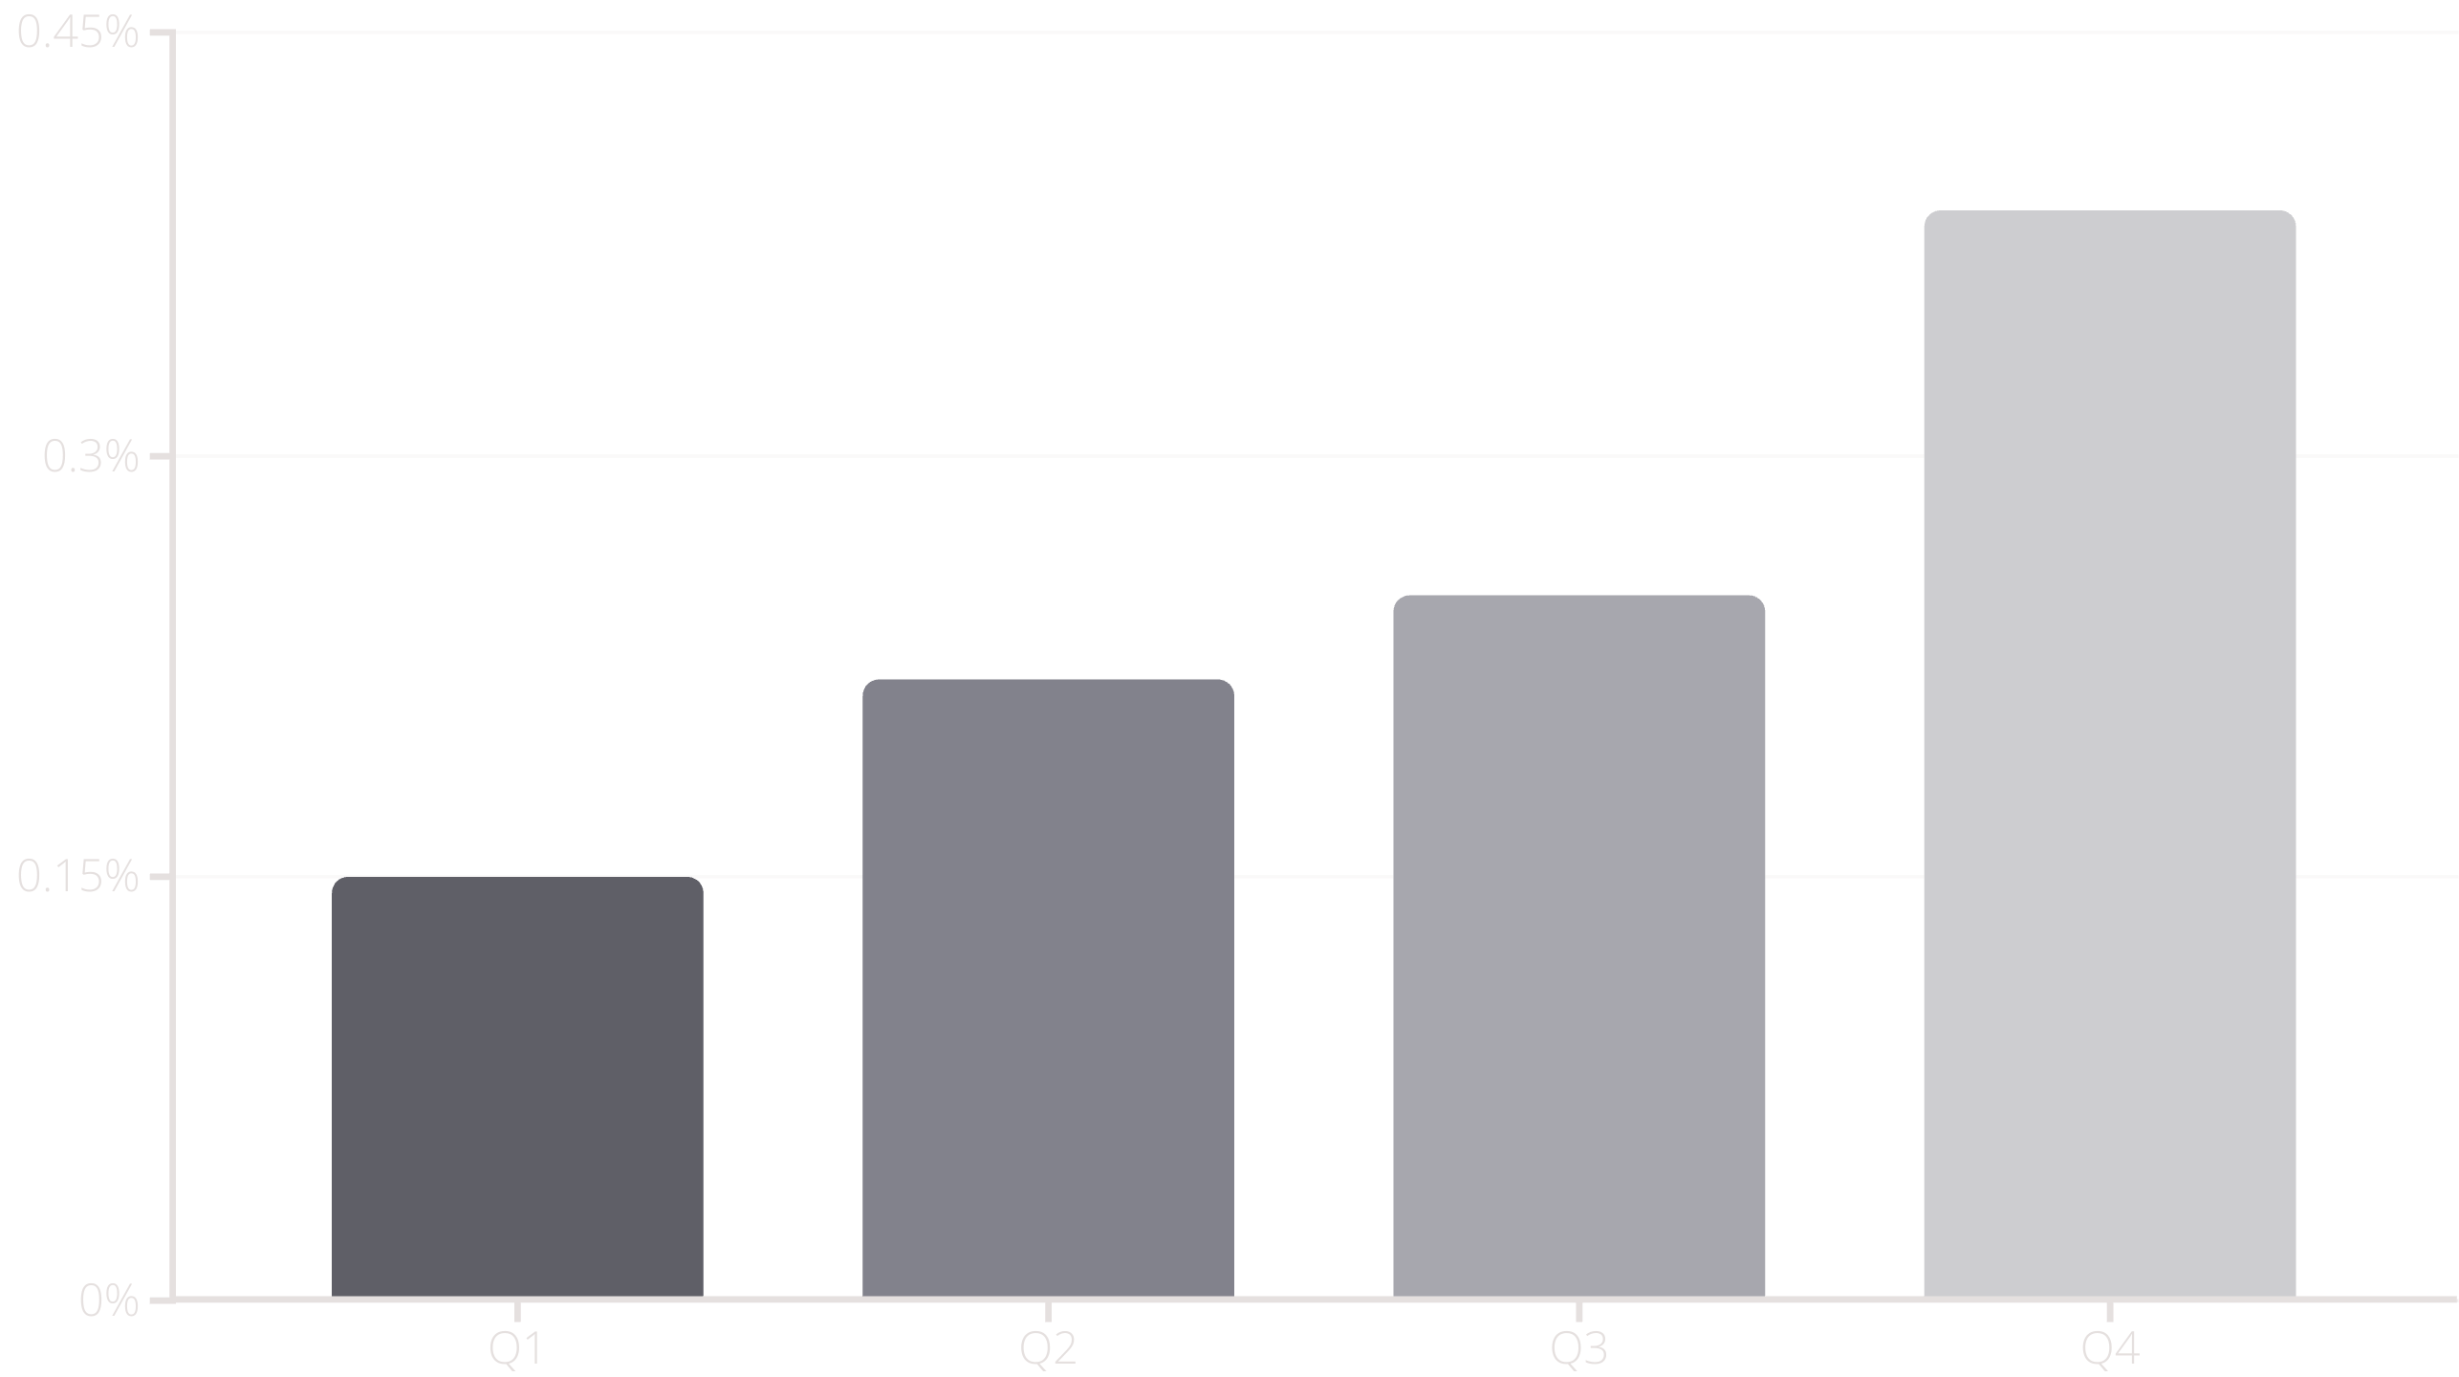
Quarterly Profit Trend
Q4 stands out, contributing 38.63% of yearly profit, driven by holiday and year-end purchasing. Q1 consistently shows lower performance. Action: Front-load marketing and sales activities for Q4 to maximize seasonal uplift.

Slide 6

Business Recommendations
1
Optimize Discount Strategy
Review and refine discounts, especially for low-margin products, to preserve profitability.
2
Focus on High-Performers
Double down on successful categories (Technology) and regions (West) through targeted investments.
3
Strengthen Customer Loyalty
Invest in programs that enhance retention and engagement for repeat customers (35-40% of sales).
4
Leverage Q4 Performance
Plan timely promotions and stock management to capitalize on peak holiday purchasing behavior.

